Slide 1
Farming and Dairy in the 1800s Our Stories: The History of Marathon County Exhibit Marathon County Historical Society
State Standards:
B.4.4 Compare and contrast changes in contemporary life with life in the past by looking at social, economic, political, and cultural roles played by individuals and groups
D.4.3 Identify local goods and services that are part of the global economy and explain their use in Wisconsin
D.4.7 Describe how personal economic decisions, such as deciding what to buy, what to recycle, or how much to contribute to people in need, can affect the lives of people in Wisconsin, the United States, and the world.

Slide 2
Who is a Farmer?
Permanent settlers hoping to secure low cost farmland
Many Irish and Germans bought 80 acres for $2 an acre.
How much would it cost for all 80 acres?
$160
The land was cheap, but it needed a lot of work before a crop could be planted.

Slide 3
How do you clear the land of trees and stumps?

Slide 4
How did he clear the land?
“The people were poor in those days. They just bought land, it was wild, they had no buildings, they had no land to work. They had to cut the timber off first. They piled up the big piles of logs and burned it so they could get some land cleared to raise a crop and they had no market.”
-Father Rudolph Raschke

Slide 5
How did she clear the land?
“After the timber was cut, the pine stumps and roots were first blasted with dynamite, then the horses had to pull the stones, the huge boulders, which this good soil seemed to have. (We have) loads and loads of stones on wagons to clear the land for cultivation.”
-Adella Radtke Cline

Slide 6
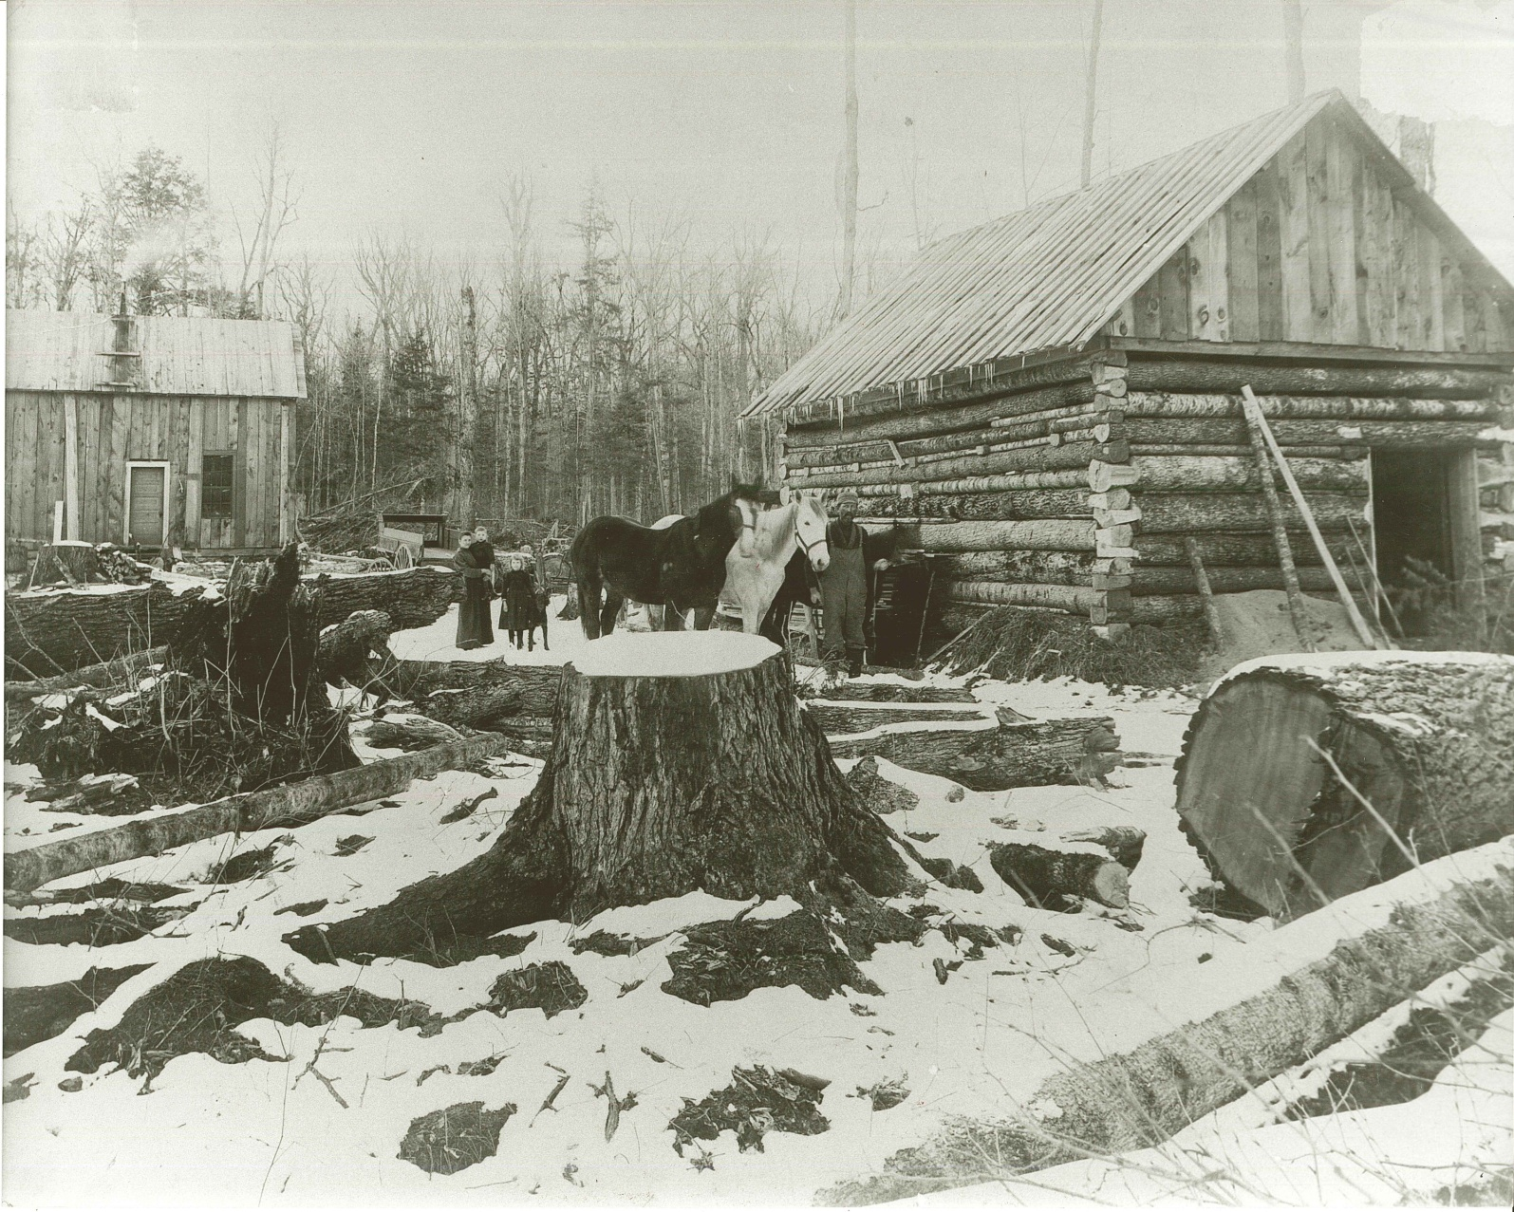
Clearing the land was hard work!
Would you work to clear away stumps and rocks from your soil?
Most farmers were subsistence farmers, they only farmed enough land to feed their families.
Many farmers had to work additional jobs such as logging in the winter.
Would you be a Marathon County farmer in the 1870s?

Slide 7
Why Dairy Cows?
They saved your back!
Cows could prosper on smaller pieces of land with stumps and rocks in it.
But now, what do you do with all the milk?

Slide 8
Cheese factories were built
Due refrigerators not being invented yet, farmers had to have their milk processed 7 days a week.
Cheese factories would collect the milk every day and make cheese.
Cheese factories became the center of rural communities.
In fact, some cheese factories were the only place in the area with a telephone and electricity!
Can you name a local cheese factory?

Slide 9
How did kids help out?
“I helped my dad at his home factory, the Wein Cheese Factory (in Edgar). We didn’t have no can washer for the farmers so we had to wash all the cans and we had about 200 milk cans that us brothers would wash.”
-Charles Mullins

Slide 10
Was every part of the milk used?
“We milked 14 or 16 cows. We hauled (the milk) to a cheese factory two miles away. First it was a creamery, they made butter, and then cheese got to be the important thing, so they separated for cheese. The whey was dumped and later on they said, shucks, we better skim that whey and make butter out of the cream from the fat that was in there. The rest of it was mainly dumped. Then they found that it was good hog feed.”
-Ema Zimmermann

Slide 11
Discussion Questions
Why is farming prominent in Marathon County?
How has farming changed from the 1870s?
Would you have put in all the work to start a farm? Why or why not?
How else could new settlers to Marathon County make money?

Slide 12
End of Farming and Dairy Presentation

